Slide 1

Supervised Learning I Tree-based Models
Gerrit Gruben, 17. July 2017

Slide 2
Outlook
Know the problem setting of supervised learning.
Understand the decision-tree based family of models, such as:
Decision Trees,
Random Forests,
Gradient-boosted Trees.
Be able to use scikit-learn and Python to fit models of this family.
Notes:
- Data Analysis o Inhalt hier sollte das Grundwissen an Statistik sein, welches man benötigt um Daten zu analysieren: § Grundlagen von Daten (Kontinuierlich, Kategorisch, …) § Korrelationen § Mittelwerte, Median,… § Standardabweichung § Verteilungen § Overview of Tools

Slide 3
Supervised Learning
… and the problem of overfitting.

Slide 4
Source: All Programming Tutorials

Slide 5
Supervised Learning (Mathematical)
Given from a joint distribution on X and Y:
training samples x₁, …, x_{n} (independent variables, features)
accompanying labels y₁,…,y_{n} (dependent variables)
Find a model f: X → Y, s. t. given only a x from this distribution, f(x) is the "best" guess. Interpretations:
Function Approximation: There is a relation y = f(x) + ε, with ε noise, and we want to estimate f.
Probabilistic: We model p(y | x), with the relation p(x, y) = p(y | x) p(x). The "perfect" model would be argmax_{y}p(y | x), i.e. the mode of the distributions p(y | x₀) for fixed x₀. This is the MAP (maximum a posteriori) estimate (we add training set to the conditional set).

Slide 6
Classification / Regression
Classification: Y discrete
#Y = 2: binary classification,
#Y > 2: multiclass classification,
If classes are not mutually exclusive: multi-label classification (best seen as multiple output model)
Regression: Y real

Slide 7
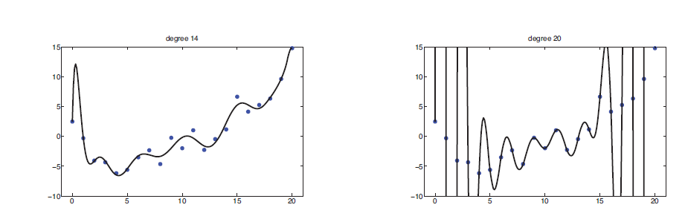
Overfitting
Overfitting = overly complex model learns noise. (aka. Bias-variances tradeoff)

Slide 8
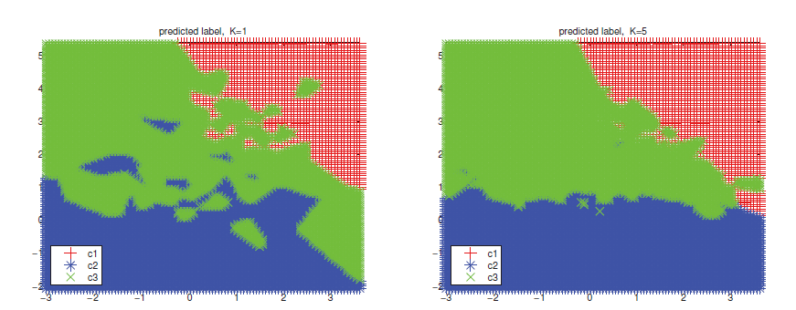
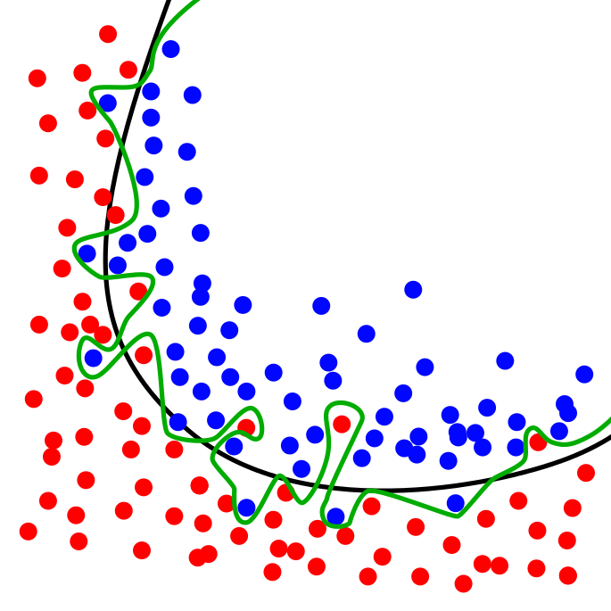
Overfitting Surfaces

Slide 9
Decision Trees

Slide 10
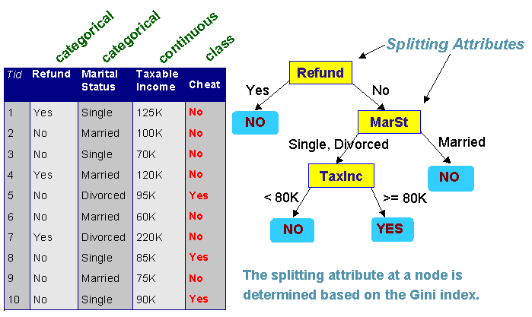
Basic Idea
Use a tree in which inner nodes split the data into two branches and terminal leafs contain a result.
Split is taken to be the one that carries “maximal” information gain.
Measured in entropy or gini.

Slide 11
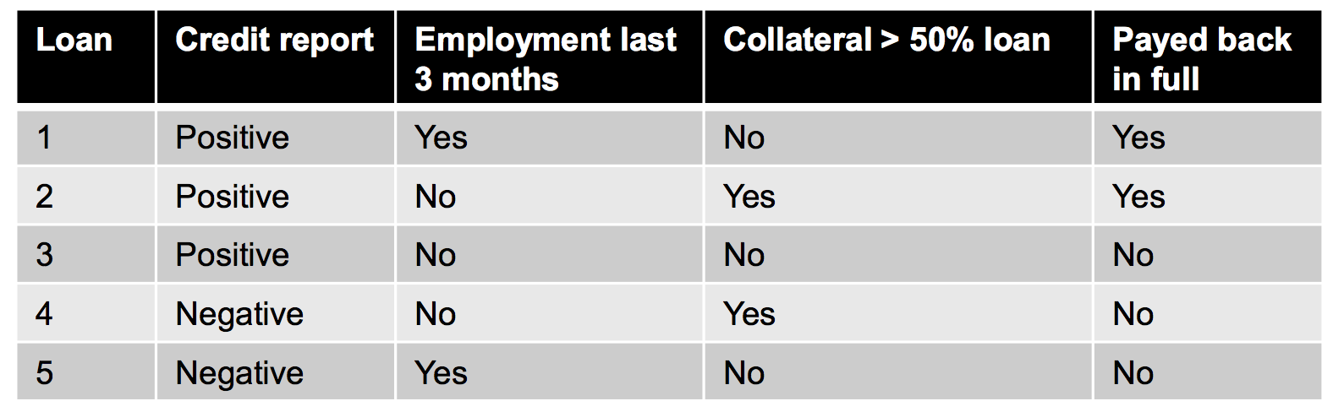
Example

Slide 12
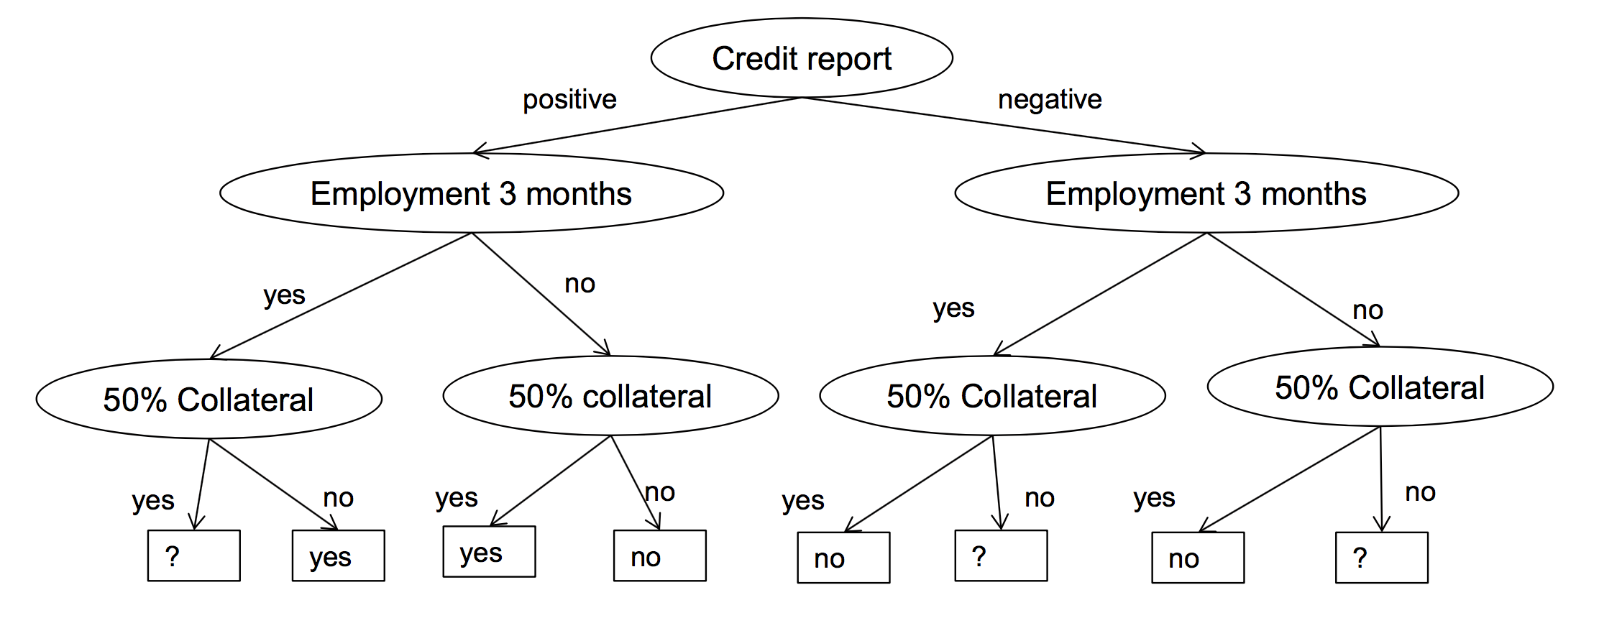
Example

Slide 13
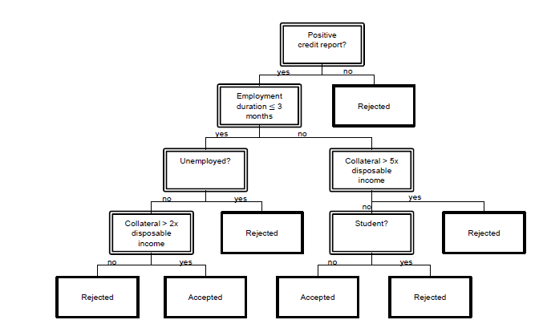
Decision Trees - Algorithms
Usually trained by CART (classically Quinlan's ID4.5/ID5.0)

Slide 14
Decision Trees II
Every leaf has data points that supports it.
sklearn.tree.DecisionTreeClassifier
criterion: "gini" / "entropy" (kind of information)
max_features: how many features to consider at split
can be integer or ratio (float), other: "auto", "sqrt", "log2", None = all
lower values to speed up, possibly avoids overfitting (unlikely)
max_depth: limits depth of tree (deep = complex = overfitting), None → unlimited expansion.
min_samples_split / leaf: minimum support for split / at leaf.
low number could lead to overfitting.
min_impurity_split: min. impurity to split.
class_weight: weight classes for splitting, "balanced": balances imbalanced classes out (usually a good thing).

Slide 15
Decision Tree III
Decision trees are famous for overfitting.
Long lost trick: Set min_samples_leaf "high" and train models for each leaf, in other words: the decision tree pre-partitions the data set roughly, then more computation intensive / better models do the rest.
High explainability.
Got popular because of ensembling / boosting.

Slide 16
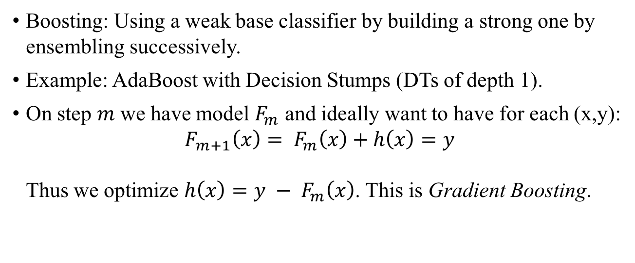
Boosting
Boosting: Using a weak base classifier by building a strong one by ensembling successively.
Example: AdaBoost with Decision Stumps (DTs of depth 1).
On step $m$ we have model $F_{m}$ and ideally want to have for each (x,y): $F_{m+1}\left(x\right)= F_{m}\left(x\right)+h\left(x\right)=y$ Thus we optimize $h\left(x\right)=y − F_{m}\left(x\right)$. This is Gradient Boosting.

Slide 17
Random Forest and GBTs
Actually got a good slide set from Jose

Slide 18

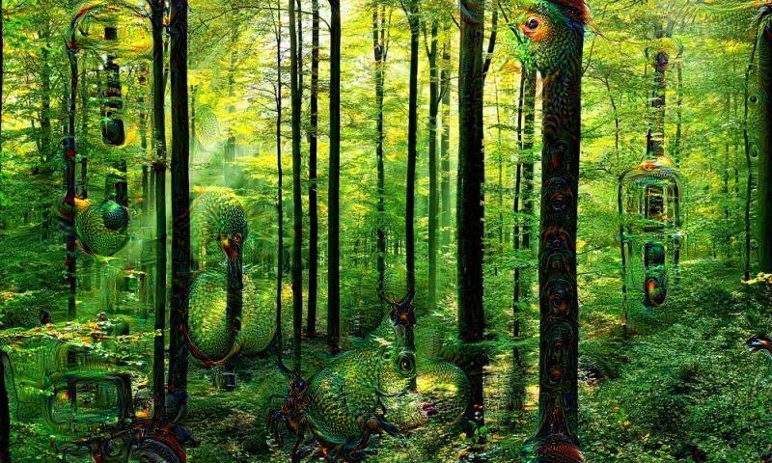
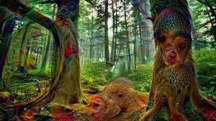
Outlook
RF family best performing one in ”Classifier olympiad” (Delgado 2014)
RF/GBT my favourite models, scale well

